Slide 1
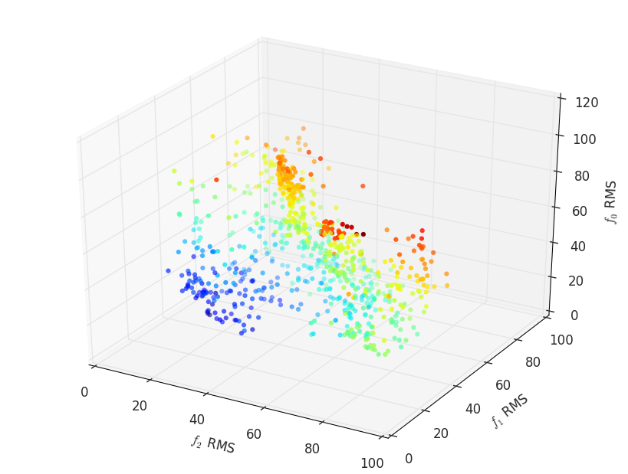
Inferring Gene Regulatory Network using Multi-objective optimization approach
NSGA-II and AMOSA
Ability to found set of diverse and more robust solutions, but not more accurate
Ability to visualize the objectives space
Future work: optimizing for both for robustness and accuracy is possible

Slide 2
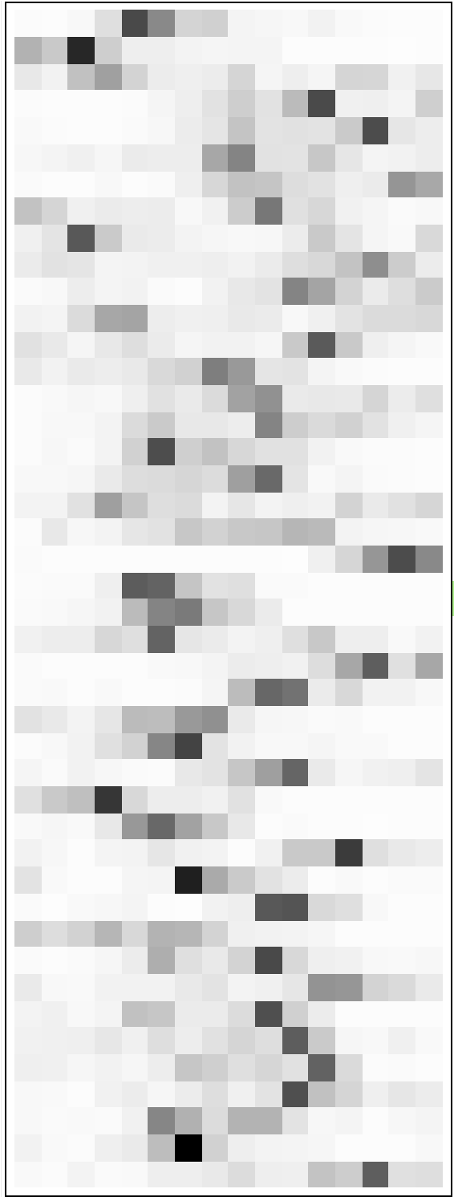
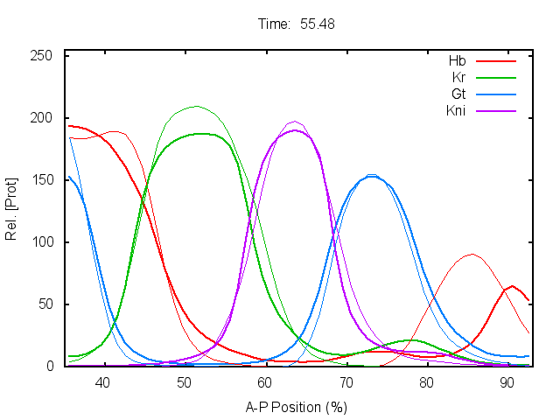
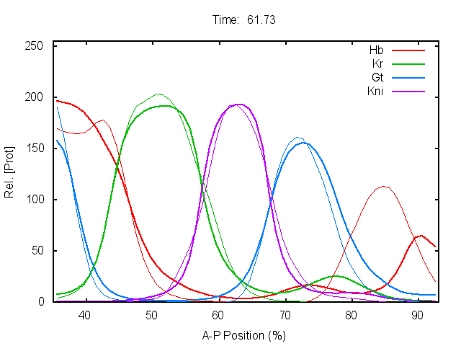
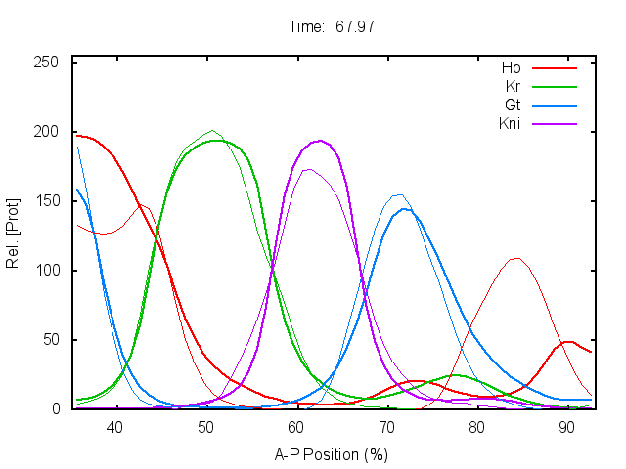
Scatter Search in C*
Fast convergence
Code features:
Modular implementation
Visualization options
Re-randomization
Warm start
Future work:
Optimizing other GRN network (Nematostella vectensis)
* under development

