Slide 1
Geuvadis main paper Supplementary figures & tables
Tuuli Lappalainen
October 10

Slide 2
INDEX
Figures
1. Schematic figure of the study design
2. Read count distributions
3. Multidimensional scaling plots of raw mRNA quantifications
4. Multidimensional scaling plots of PEER-normalized mRNA quantifications
5. Multidimensional scaling plots of raw miRNA quantifications
6. Multidimensional scaling plots of PEER-normalized miRNA quantifications
7. Replicate correlations across individuals and labs for PEER-normalized data
8. Transcript quantification statistics
9. Transcript quantitative vs qualitative variation across populations
10. Population differences in expression and splicing
11. Variation in splice junctions
12. Fusion genes
13. n-TARs?
14. RNA editing?
15. miRNA variation
16. Schematic drawing of allele-specific analyses
17. ASE parameters and quality control
18. Population variation of allele-specific expression
19. Population variation of allele-specific alternative splicing
20. Population sharing of transcriptome QTLs
21. Correlation of transcriptome features of the same gene
22. Sharing of QTL signals for transcriptome features within the same gene
23. Causal QTL variant discovery
24. SNP / indel / structural variant contributions to tQTL associations
25. eQTL and sQTL trans effects
26. Functional annotations of QTL variants
27. GWAS and QTL overlap
28. Splice site scores
29. LoF: NMD
30. LoF: other stuff?
31. Data access schema
32. Ensembl track examples
Tables
1. Variant annotation statistics
2. Numbers of differentially spliced and expressed genes

Slide 3
Figure S1.
Schematic figure of the study design
Pending (Tuuli)

Slide 4
Figure S2. Total mRNA (a) and miRNA (c) read counts ; counts of well-mapped mRNA reads (MAPQ>150 properly_paired & NM<=6) ; and counts of well-mapped miRNA reads (mapping to miRNA hairpins) (d).
miRNA final versions (Tuuli)

Slide 5
Figure S3. Multidimensional scaling of pairwise sample correlations based on exon (a, c) and transcript quantifications (b ,d) normalized only for the total number of mapped reads, with population colors (a, b) and lab colors (c ,d). All QC-passed 660 individuals are included.
Use plots of 462. Add legends (Tuuli)

Slide 6
Figure S4. Multidimensional scaling of pairwise sample correlations based on exon (a, c) and transcript quantifications (b ,d) after PEER normalization (see Supplementary methods), with population colors (a, b) and lab colors (c ,d). All QC-passed 660 individuals are included.
Pending (Tuuli)

Slide 7
Figure S5. Multidimensional scaling of pairwise sample correlations of miRNA quantifications normalized only by total number of mapped reads, with population colors (a) and lab colors (b). All QC-passed 480 individuals are included.
Add legend (Tuuli)

Slide 8
Figure S6. Multidimensional scaling of pairwise sample correlations of miRNA quantifications normalized by PEER, with population colors (a) and lab colors (b). All QC-passed 480 individuals are included.
Pending (Tuuli)

Slide 9
Figure S7. Correlation of replicate samples based on mRNA and miRNA gene quantifications after PEER normalization.
Pending (Tuuli)

Slide 10
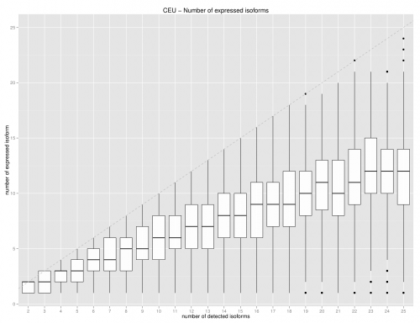
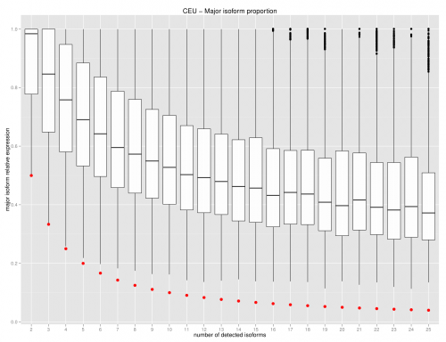
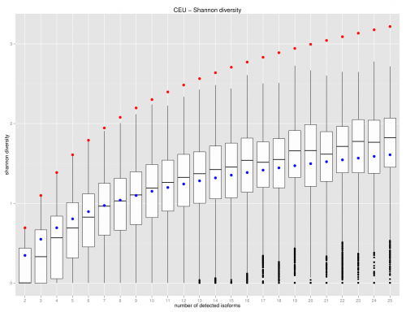
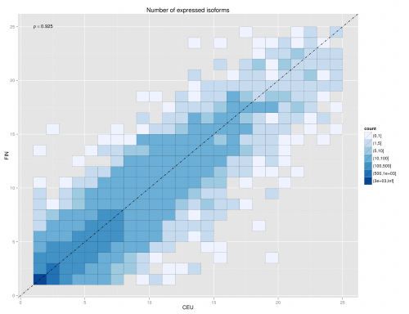
Figure S8. Transcript quantification statistics: Number of expressed isoforms (a), ratio of the most common isoform of the total (b), and Shannon entropy of the transcript ratios per gene (c) calculated in CEU, number of expressed isoforms in CEU and FIN (d). Other populations and population pairs show virtually identical patterns (data not shown).
Prettier figures needed (Jean). Use GBR or FIN (novelty value)

Slide 11
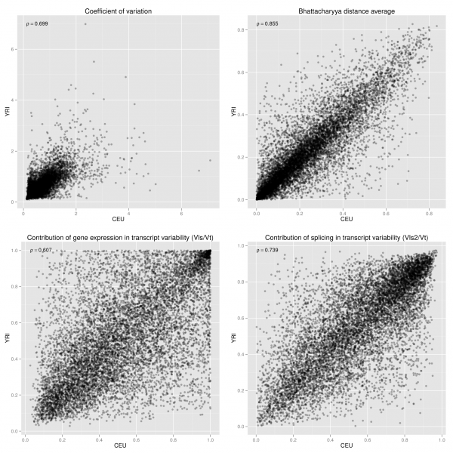
Figure S9. Comparison of qualitative and quantitative transcript variation between CEU and YRI: Distributions of the coefficient of variation (a), splicing variability measured as Bhattacharyya distance (b), contribution of gene expression levels to total variation measured as Vls/Vt (c) contribution of splicing to total variation measured as Vls2/Vt (d). Other population pairs show very similar patterns (data not shown)
Prettier figures needed – can we have them of all pairs? Quantitative analysis of population differences (Jean).

Slide 12
Figure S10. Differential splicing and expression.
Differential isoform usage
Differential gene expression
changes in
splicing
changes in transcription
changes in splicing explained by changes in transcription
Example 1
Example 2
Example 3
Venn diagram and examples (Mar & Pedro)

Slide 13
Figure S11. Variation in splice junctions.
Fgure(s) of splice junctions (novel/annotated, rare/common…)
Figure(s) of soft splicing variation
Figures needed (Micha, Matthias)

Slide 14
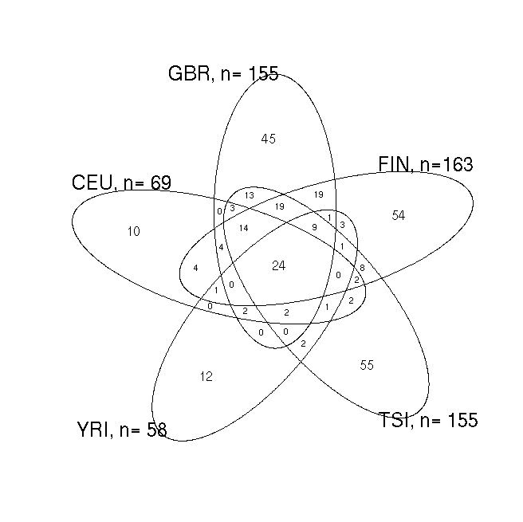
Figure S12. Fusion genes. Numbers and sharing of fusion genes in the populations (a), the frequency distributions of these genes split by known and novel fusion genes, and distances between the breakpoints of parent genes (c)
Freq distributions:
all populations in the same plot, split by known and novel
Distances between breakpoints: all populations in the same plot
Freq vs distance scatterplot
Prettier figures needed (Liliana)

Slide 15
Figure S13. RNA editing
Pending (Thomas)

Slide 16
Figure S14. n-TARs
Pending (Daniela)

Slide 17
Figure S15. miRNA variation (miRNA-mRNA here too or separately)
Pending (Marc, Maarten)

Slide 18
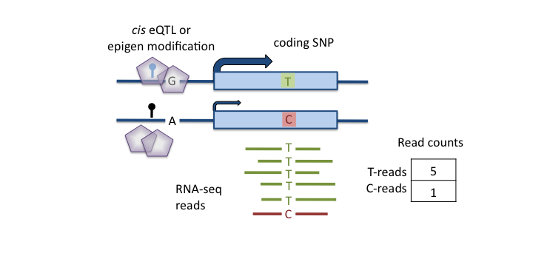
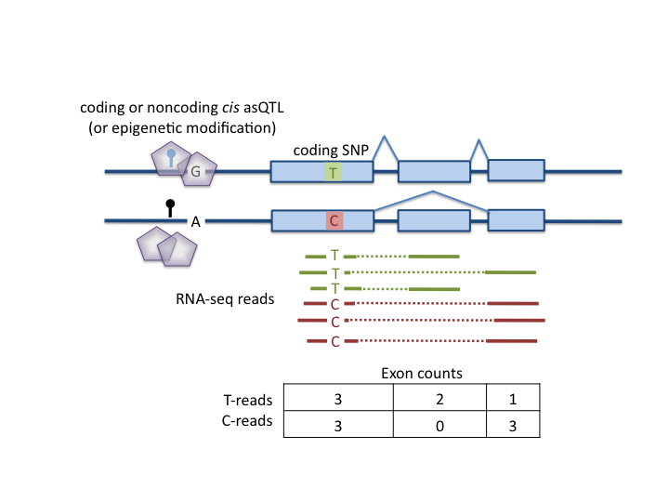
Figure S16. Schematic drawings of allele-specific expression ASE (a) and allele-specific alternative splicing ASAS (b)

Slide 19
Figure S17. ASE analysis methods. Nucleotide bias in ASE ratios that is corrected for in analysis (a), proportion of significant ASE for full data (b) and when both alleles are seen (b), with samples in the lower 25% of RNAseq heterozygote concordance with genotypes marked in red. (c) shows differences in allelic ratios between replicates of the same sample as a function of coverage, and (d) shows distribution of allelic ratio distances by laboratory

Slide 20
Figure S18. Allele-specific expression. Multidimensional scaling of pairwise allelic ratio distances between individuals colored by population (a) ; distributions of allelic ratio differences between two haplotypes of an individual, replicate samples from the same individual, two individuals from the same population, different European population, or different continent ; ASE effect size (absolutely distance from the expected allelic ratio of 0.5) as a function of frequency of the ASE effect in the population.

Slide 21
Figure S19. Allele-specific alternative splicing. ASAS effect size (maximum difference between reference and alternative ratios; see methods) as a function of frequency of the ASAS effect in the population ; sharing of ASAS and ASE with the figure showing the distribution of ASE p-values for ASAS significant sites. The ASE p values are calculated from data samples to exactly 30 reads per site in order to avoid bias from coverage.
Freq distribution
Freq distribution pending (Tuuli). More work on ASE-ASAS sharing

Slide 22
Figure S20. Population sharing of QTLs. Venn-diagrams of eQTL (a) and sQTL (b) sharing as well as distributions of the p-values in one population for the associations that are significant in the other population, with the numbers denoting the pi1 statistic (c, d).
eQTL VENN
sQTL VENN
p-distribution EUR->YRI
eQTL & sQTL
p-distribution YRI->EUR
eQTL & sQTL
Pending (Tuuli)

Slide 23
Figure S21. Correlation of transcriptome features within a gene. Correlation between expression levels of exons of the same gene for chr20 (a) ; correlation between exon inclusion ratios within the same gene for exons with …PSI in some range (b) ; correlation between expression levels of exons and exon inclusion ratios within the same gene (c)
junction/PSI/? correlation
exon vs junction/PSI/? correlation
Splicing part pending (Tuuli)

Slide 24
Figure S22. Overlapping and independent QTLs within the same gene.
Pending (Tuuli) – working on this now
Something from here might end up as main figure

Slide 25
Figure S23. Causal QTL variant discovery. Rank of the best Omni2.5M SNP in the full dataset (a) and distribution of the difference in p-values between the best and the 2nd best variant in EUR and YRI for the full set of common variants, and for Omni2.5M variants (b).
Pending (Tuuli)
Something from here might end up as main figure

Slide 26
Figure S24. SNP, indel and structural variant contributions to QTL discoveries. The barplots show the relative proportions of variant types in the cis-regions and among significant cis-eQTLs and sQTLs (a), and the trans-p-value distributions of each cis-QTL type are shown in (b)
Pending (Tuuli)

Slide 27
Figure S25. Trans-effects. Trans association p-value distributions for cis-eQTLs (a), cis-sQTLs (b), and for coding variants in cis-QTL genes (c) or in genes without a cis-QTL (d), and finally in intergenic SNPs as a null (e)
Pending (Tuuli)
Something from here might end up as main figure

Slide 28
Figure S26. eQTL (a) and asQTL (b) annotations for the best, 2nd, 5th and 10th best associated variant and for a null selection of SNPs lacking the QTL association but with matched minor allele frequency, distance from TSS, and expression level of the closest gene
Pending (Tuuli)

Slide 29
Figure S27. QTL p-value distribution for GWAS SNPs: eQTLs (a) and asQTLs (b), with the numbers denoting the pi1 value.
Pending (Tuuli)

Slide 30
Figure S28. Splicing score predictions of variants overlapping an annotated splice motif. Distribution of scores for reference and alternative alleles for donor (a) and acceptor (b) sites, and allele frequency distributions for variants with different predicted effects (b).
Allele freq distributions
Prettier figures needed (Micha)

Slide 31
Figure S29. Loss-of-function variation and nonsense-mediated decay. Alternative allele ratio for a random set of synonymous variants (null) in (a) and for stop-gained variants (b), from one random individual per site.

Slide 32
Figure S30. Loss-of-function variation – further plots?
Pending (Manny, Tuuli, Micha)

Slide 33
Figure S31. Data access schema
Pending (Natalja)

Slide 34
Figure S32. Ensembl tracks: examples
Pending (Natalja)

Slide 35
Table S1: Annotation statistics of genetic variants: number of variants in each category
(All 1000g sites & Geuvadis polymorphic sites)
Pending; Monkol & Daniel

Slide 36
Table S2: Number of genes with differential splicing ratios (lower triangle) and differential expression (upper triangle)
 | CEU | FIN | GBR | TSI | YRI
CEU |  | 570 | 723 | 551 | 236
FIN | 40 |  | 228 | 116 | 350
GBR | 50 | 21 |  | 65 | 344
TSI | 23 | 0 | 0 |  | 167
YRI | 133 | 70 | 63 | 43
Update splicing (Mar)

