Slide 1
Geuvadis main paper figures & tables
Tuuli Lappalainen
October 9

Slide 2
Messages of the tables/figures
Table 1. We characterize population variation in a deep, diverse set of transcriptome features
Fig 1. Distributed sequencing works
Fig 2. a) We discover much more by deep sequencing across individuals
b) Populations can differ both in terms of expression levels and splicing, although splicing patterns are generally consistent between populations
c) We can characterize novel features of transcriptome variation
d) Population variation in miRNA levels regulates the target mRNA levels
Fig 3. a) We find a lot of transcriptome QTLs with both overlapping and independent effects to different transcriptome features of the same gene
b) Genome-sequencing data gives us access to likely causal variants whose annotation uncovers regulatory mechanisms
Fig 4. a) Most allelic variation between individuals is driven by rare effects, depending on how closely related the individuals are
b) Allele-specific alternative splicing uncovers rare splicing effects
c) Mapping putative rare regulatory variants…tells us something about their properties
Fig. 5 a) Stop-gained variants cause NMD often but not always
b) We can predict splicing effects of genetic variants based on positions and splice motifs, and observe the effects in transcriptome variation data
c) Loss-of-function effects are often compensated for in the cell: The (lack of) effect of NMD on gene quantification
Find figures to better illustrate:
rare variation in the transcriptome: there’s a lot of it, but it’s often lacking from the annotation
other points?

Slide 3
Table 1: Statistics of the data for the nonredundant QC-passed samples - 462 for mRNA, 452 for miRNA.
 | Median (min-max) per individual | Total | significant
Total mRNA reads | 58.4 M (17.3-166.6) | 27612 M | NA
Well mapped mRNA reads 2 | 48.8 M (15.0-139.5) | 23092 M | NA
Genes 3 | 16396 (15021-18002) | 14779 | 7924
Exons 3 | 150869 (133660-165224) | 141951 | 34294
Transcripts 3 | data exists | 74533
Splice junctions 3 | data exists | 134293
Soft splicing events
Fusion genes
Novel transcriptionally active regions
RNA edited sites
ASE sites 4 | 8420 (3823 - 19224) | 4042778 | 271424
ASAS sites 5 | 2135 (740 – 4443) | 1012758 | 60753
Total miRNA reads | 8.8 M (2.2-50.0) | 4823 M | NA
QC-passed miRNA reads 6 | 1.2 M (0.21-15.5) | 775 M | NA
miRNA genes 3 | 761 (359-1158) | 706 | 62
1 Nonredundant count of tQTLs in EUR+YRI, or significant allele-specific effects (p<0.005)
2 Unique mapping with number of mismatches <=6
3 Individual: >0 reads, across samples: >0 in >50% of samples
4 >=16 reads, both alleles seen
5 >=10 reads per allele
6 Mapping to miRNA hairpin sequences

Slide 4
Figure 1: Correlation of replicate samples based on mRNA and miRNA gene quantifications. The quantifications have been normalized for the total number of mapped reads; see Supplementary Figure x for correlations after further regression of synthetic covariates that reduces lab effects further (or should we include that figure here?).
NA
INDV: SAME SAME DIFF DIFF
LAB : SAME DIFF SAME DIFF

Slide 5
Figure 2: Transcriptome variation. a) Number of genes quantified in the total sample set as a function of sequenced samples for nonredundant 462 individuals (green) and for 5 replicate samples sequences 8 times each (blue). The order in which the individuals are added has been permuted x times; the thick lines show the median and the shaded areas show the minimum and maximum across permutations. c) Some particularly cool transcriptome feature d) miRNA-mRNA interactions
The coolest transcriptome variation feature
miRNA-mRNA interaction

Slide 6
Figure 3. Transcriptome QTLs. a) Something to illustrate tQTLs. Or a table? b) Enrichment of eQTL and sQTL putative causal variants in functional annotations relative to a matched null distribution (see supplementary methods). eQTLs have been divided to those increasing (dark blue) and decreasing (light blue) expression. sQTLs are shown in green. c) Pi1 of eQTL and sQTL p-values for GWAS SNPs
transcriptome QTLs (x1-3)
etc….
H3K27ac PolII DNase1

Slide 7
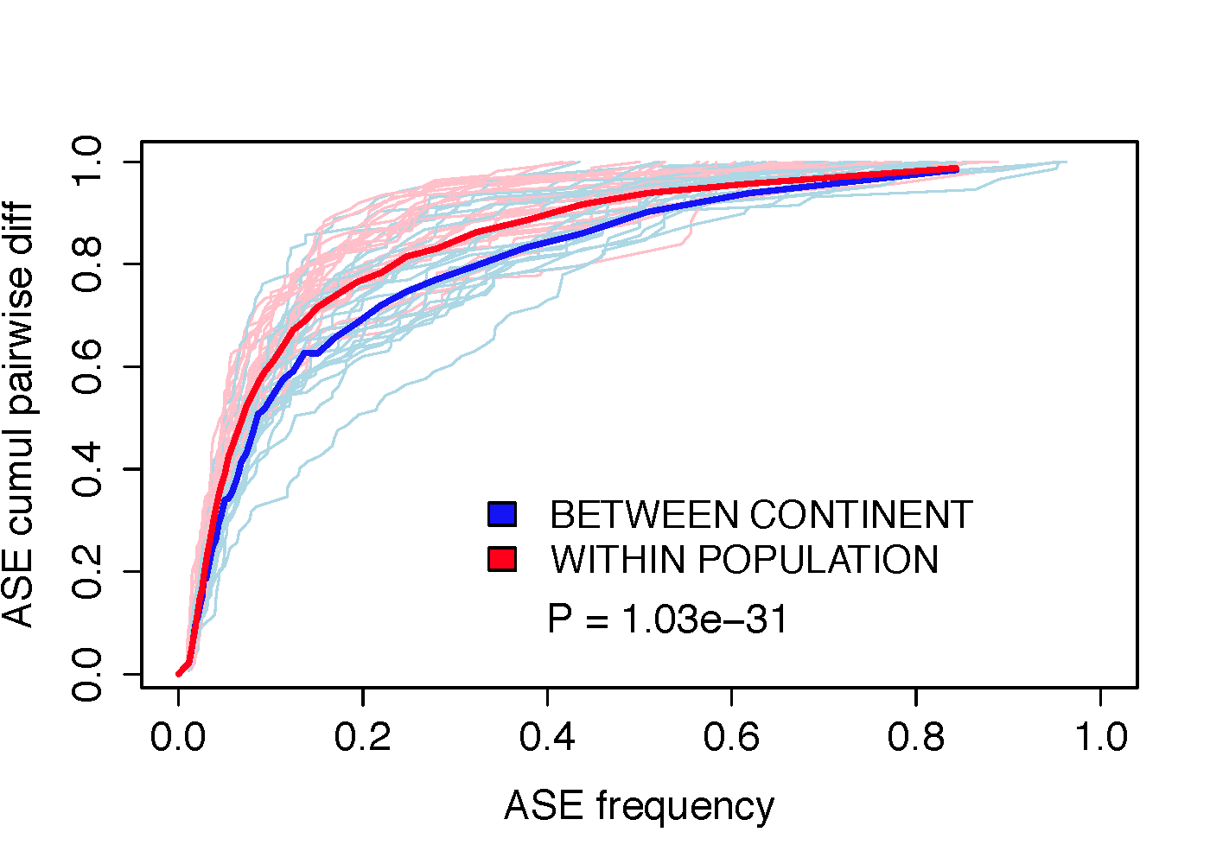
Figure 4 : Rare allelic effects a) Cumulative difference in allelic ratios between two individuals as a function of the population frequency of ASE events. For each individual pair, we selected ASE sites where the individuals are discordant for significant ASE, and calculated the proportional contribution of each site to the total allelic difference between the individual pair. This is plotted as a function of population frequency of the ASE event, which is a proxy for frequency of the regulatory event underlying the ASE. The thick lines show medians across all measured sample pairs from different continents (red) or form the same population (red), and the thin lines show a random selection of 25 individuals of individual pairs. b) Something about ASAS (a lot of analysis done, but unsure which is the best plot) c) Something about rare variant mapping
ASAS
Rare variant mapping

Slide 8
Figure 5: Transcriptome effects of loss-of-function variants. a) Allele-specific expression in premature stop variants. Variants are on the x-axis sorted by derived allele frequency, and the derived allele ratio is shown on the y-axis, with dots showing the median and vertical lines the range of derived allele ratio all the samples with the variant. INTEGRATE B and C about predicting splice effects b) Effect of variants on RNAseq splice junction quantifications as a function of their distance from the exon-intron border for donor sites and acceptor sites. c) Exon inclusion score of exons that harbor variants predicted to destroy the splice motif. Only exons that show some alternative splicing in this dataset (0.2 < mean inclusion score < 0.8) are included. d) Compensation of loss-of-function variants: NMD often doesn’t lead to decreased expression
green: alt/alt homoz
ref: ref/alt
blue: ref/ref homoz
NMD compensation

