Slide 1
Geuvadis main paper figures & tables
TL September 26
Very preliminary!

Slide 2
Table 1: Statistics for the nonredundant QC-passed samples(462 for mRNA, 452 for miRNA)
 | Median (min-max) per individual | Total | cis-tQTLs / signf AS 1
Total mRNA reads |  |  | NA
QC-passed mRNA reads 2 |  |  | NA
Genes 3 |  | 14779 | 7924
Exons 3 |  | 141951
Transcripts 3
Splicing events
Soft splicing events
Fusion genes
Novel transcriptionally active regions
RNA edited sites
ASE sites 4
ASAS sites 5
Total miRNA reads |  |  | NA
QC-passed miRNA reads |  |  | NA
miRNA genes
1 Nonredundant count of tQTLs in EUR+YRI
2 Unique mapping with number of mismatches <=6
3 Individual: >0 reads, across samples: >0 in >50% of samples
4 >=16 reads, significant: p<0.005
5 >=20 total reads, >=10 reads per allele, significant: p<0.005

Slide 3
Figure 1: Correlation of replicate samples based on mRNA and miRNA gene quantifications before and after normalization.
Final version: update mRNA, add miRNA, add normalized

Slide 4
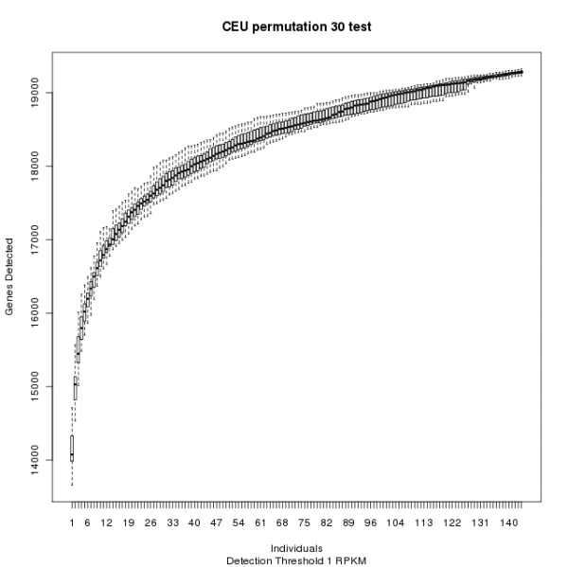
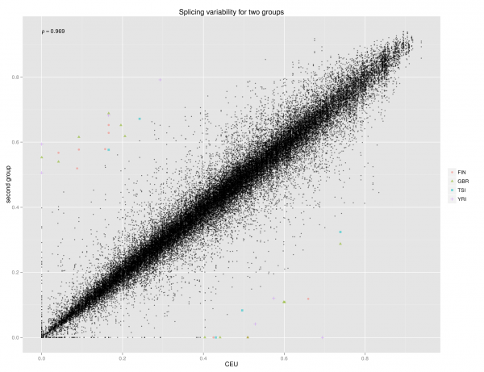
Figure 2: Transcriptome variation. a) Number of genes quantified in the total sample set as a function of sequenced samples [update, final version with different individuals and replicates separated]. b) Splicing variability between CEU and the other populations. The inserts show examples of transcript quantifications: a gene with differential expression but consistent splicing between populations, and a gene with similar expression but differential splicing between populations. c d? e?) Something descriptive of population variation in transcriptome features (splicing, fusion genes, n-TARs, editing, miRNA…). One figure merging similar statistics of all, or a couple of subpanels. x) miRNA-mRNA interactions

Slide 5
Figure 3. Transcriptome QTLs. a) Some general plot about tQTLs. Or a table?? b) Enrichment of eQTL and sQTL putative causal variants in functional annotations relative to a matched null distribution (see supplementary methods). eQTLs have been divided to those increasing (dark blue) and decreasing (light blue) expression. sQTLs are shown in green.
etc….
H3K27ac PolII DNase1

Slide 6
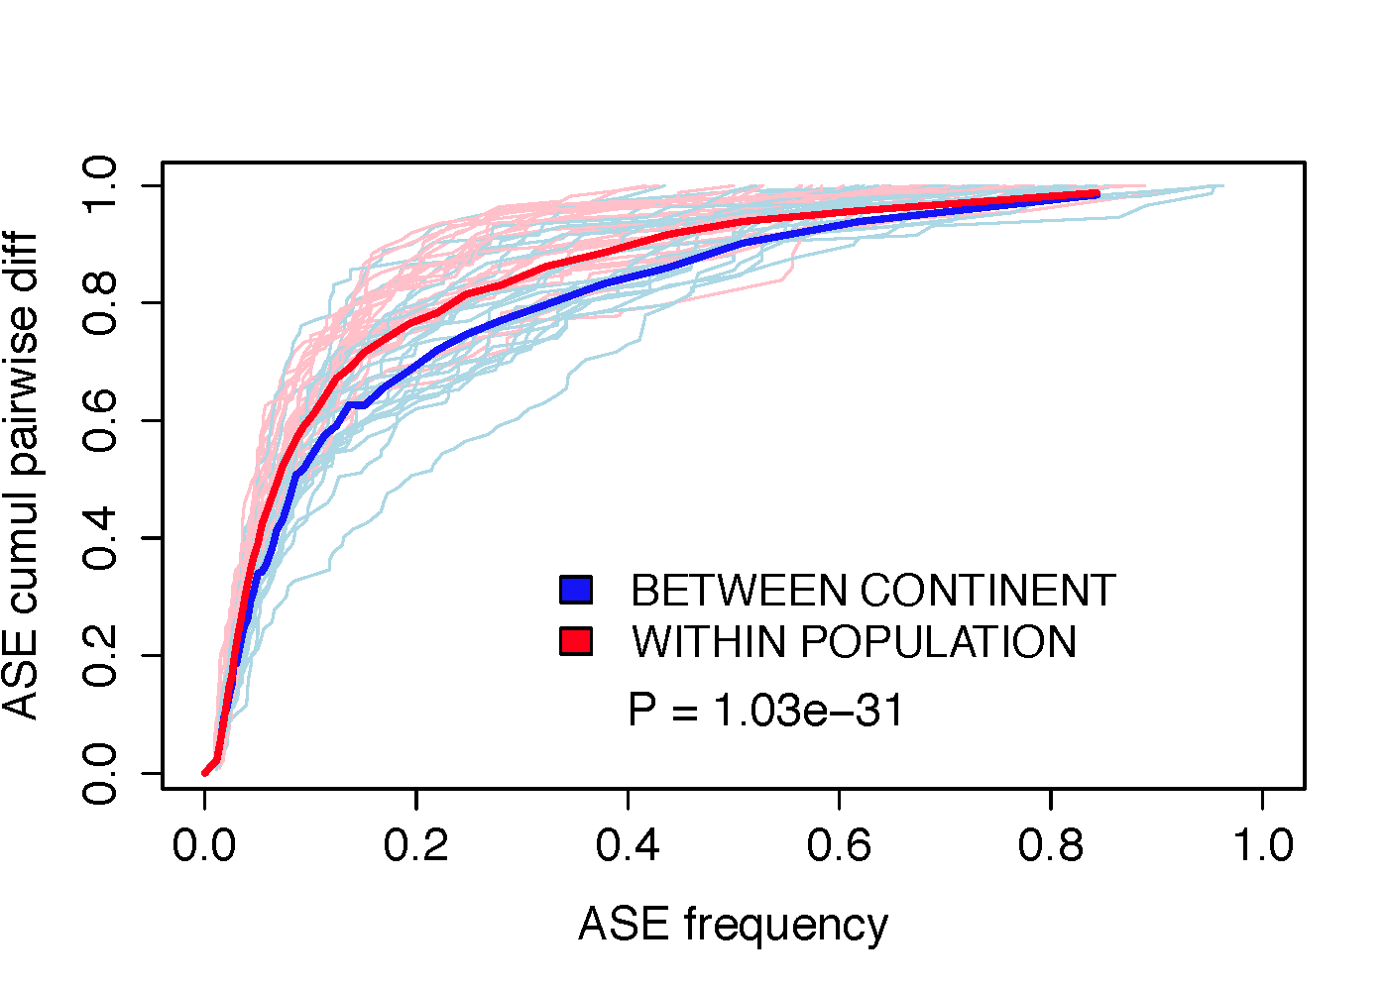
Figure 4 : Rare allelic effects a) Contribution of allele-specific expression events to cumulative allelic expression variation between individual pairs partitioned by the population frequency of ASE events. The thick lines show medians across all measured sample pairs, and the light blue and pink lines show a random selection of 25 individuals of each category. [Add ASAS to the same plot if possible!] b) Something about rare variant mapping

Slide 7
Figure 5: Transcriptome effects of loss-of-function variants. a) Allele-specific expression in premature stop variants. Variants are on the x-axis sorted by derived allele frequency, and the derived allele ratio is shown on the y-axis, with dots showing the median and vertical lines the range of derived allele ratio all the samples with the variant. b) something about predicting escape from NMD c) Effect of variants on RNAseq splice junction quantifications as a function of their distance from the exon-intron border fo donor sites and acceptor sites [maybe update this using splice scores]. d) Something about compensation of loss-of-function variants (NMD? enrichment in lower expressed haplotypes/exons?)

