Slide 1
SMARTAR: small RNA transcriptome analyzer
Geuvadis TC March 8th 2012
Esther Lizano and Marc Friedländer
Xavier Estivill lab
Programme for Genes and Disease
Center for Genomic Regulation (CRG)

Slide 2
Overview of analysis
1: quality control
2: pre-processing
3: length profiling
4: miRNA de novo discovery
5: profiling of (iso-) miRNAs
6 : genome mapping
7: annotation breakdown
8: visualization of data
9: summary of results

Slide 3
1: quality control
1a: sequencing reads are trimmed to 36 nts (to reduce batch effect)
1b: PHRED quality scores are visualized
software: FASTX package from Hannon lab

Slide 4
1: quality control (“good” quality example)

Slide 5
2: pre-processing
2a: homo-polymer filtering (if 33 or more of the nts are the same)
2b: quality filtering (if more than 50% of the nts have PHRED 10 or less)
2c: adaptor clipping (searches for first 8 nts of adapter, 1 mismatch allowed)
2d: identical sequences are collapsed (to FASTA format)
2e: length filtering (if clipped sequence is less than 18 nts)
software: seqbuster, adrec, mapper.pl, FASTX.

Slide 6
3: length profiling (the “good”)

Slide 7
3: length profiling (the “bad”)

Slide 8
3: length profiling (the “ugly”)

Slide 9
4: miRNA de novo discovery
4a: reads are mapped stringently to the genome
4b: potential miRNA hairpins are excised using mappings as guidelines
4c: for each potential miRNA hairpin a score is assigned based on:
RNA structure and
positions of sequenced RNAs
software: miRDeep2

Slide 10
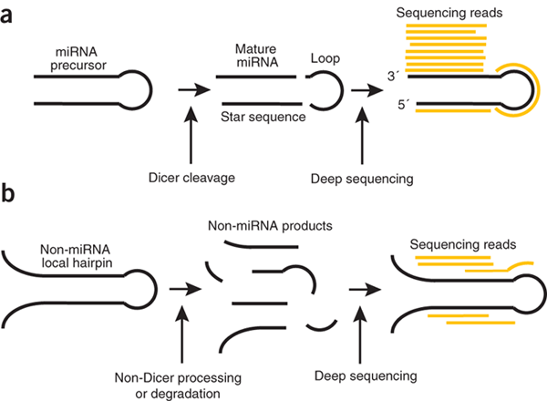
4: miRNA de novo discovery
when miRNA precursors are processed by the Dicer protein, three products are released (a)
when mapped back to the precursor, these products will fall in a particular pattern (the ‘signature’)
in contrast, random degradation will not follow this pattern (b)
the fit of sequenced RNA to this model of biogenesis is scored probabilistically by miRDeep
Figure from Friedländer et al.,
Nature Biotech. 2008.

Slide 11
5: profiling of miRNAs and isoforms
reads are aligned to precursors allowing 1 mismatch and 1 addition in the 3’ end
if a read locates within the boundary of the annotated mature miRNA (plus / minus 3 nts) it is annotated as such
if a read maps equally well to more than one miRNA, it is counted towards all of them
software: seqbuster, miraligner

Slide 12
seqbuster vs. mirdeep2 profiling

Slide 13
6: genome mapping
6a: reads are mapped to the genome, allowing one mismatch and an infinite number of mappings
also included are the unassembled parts of the human genome and genomes of known human viral pathogens
6b: the mappings are converted to nucleotide-resolution intensities
e.g. if a nucleotide is covered by a read with a single genome mapping and a read with ten genome mappings, it will be assigned an intensity of 1 + 0.1 = 1.1
software: bowtie and custom source

Slide 14
7: annotation breakdown
7a: intensities are intersected with simple annotation (15 classes)
7b: intensities are intersected with detailed annotation (40 classes)
7c: intensities are intersected with individual gene annotations (>3 million classes)
annotations are based on GENCODE version 8, but custom annotations are used for miRNAs, snoRNAs, rRNAs, LINEs, Alus, introns and anti-sense annotations.
each nucleotide on each strand has exactly one annotation. This is resolved using a priority hierarchy
software: custom source

Slide 15
7: simple annotation breakdown (the “good” and the “ugly”)

Slide 16
8: visualization (the miRNA “onco-cluster”)
sRNA data peaks
miRNA precursor hairpins
miRNA primary transcript

Slide 17
9: summary
10a: summary is given how many reads were:
quality filtered
length filtered
not mapped to the genome
successfully mapped to the genome
typically around 90% of the reads are mapped to the genome.
software: custom source

Slide 18
Standard features of SMARTAR
pre-processing
quality control (phred scores, length profiling)
miRNA de novo discovery
miRNA profiling
visualization

Slide 19
Added features of SMARTAR
almost all reads (90%) are traced to the genome
profiles transcripts genome-wide (including snRNAs, snoRNAs, etc.)
quantifies miRNA isoforms (also potentially interesting for SNPs)
considers unassembled parts of the genome
considers genomes of human viral pathogens
analysis requires one command line per project
all output is in spread-sheets, some also in graphics

Slide 20
Downstream analysis
tweeDEseq (Juan Ramón Gonzalez) can identify differentially regulated transcripts
uses Poisson and negative binomial statistics to accurately model lowly and highly expressed transcripts
requires large sample numbers (which we have)
once differentially regulated transcripts are identified, in-depth characterization can begin.

