Slide 1
Geuvadis WP4: RNA sequencing Progress and Aims
Tuuli Lappalainen
University of Geneva
Geuvadis Annual Meeting 2011, Toulouse

Slide 2
Genomics, meet transcriptomics RNA sequencing of ~500 individuals from the 1000 Genomes
 | Geuvadis | in 1000G Phase1
TSI | 93 | 92
GBR | 96 | 86
FIN | 95 | 89
CEU | 92 | 79
YRI | 89 | 77
TOTAL | 465 | 423
FIN
GBR
CEU
TSI
All the 465 samples have Omni 2.5M genotypes
YRI
Integrated haplotypes of SNPs, indels, structural variants of total ~ 13M variants (7M MAF > 5%) + mRNAseq + miRNAseq

Slide 3
Samples
Transformed lymphoblastoid cell lines from Coriell & UNIGE
Cell culture at ECACC: Cell pellets for RNA isolation + cell banks for all the partners
RNA extracted at UNIGE
Sequencing in 7 partner labs
Randomization of the sample processing
UU
48
ICMB
72
LUMC
MPIMG
48
72
HMGU
UNIGE
48
111+354
CRG/CNAG/USC
96

Slide 4
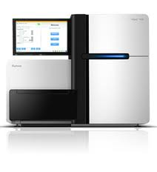
Sequencing
mRNAseq: 2 x 75bp, minimum of 20M mapping reads per sample
total ~15 billion mapping reads
miRNAseq: 1 x 36bp, minimum of 3M total reads per sample
total ~1 billion mapping reads
All sequencing in HiSeq with the latest TruSeq kits
standardization of the methods as much
as possible

Slide 5
Progress and timeline
Thomas / Tuuli
QC mapping
cell line shipments and growing
2010: Pilot of 5 samples, 7 labs
sequencing
2011
2012
RNA extraction pilot
10/1212
paper submission
study design
sample selection
RNA extraction
08/2012
analysis finished
05/2012
CSHL?

Slide 6
Why are we doing this?
We might want to do RNAseq in a big scale. What do we get out of it? What are the best methods?
This is probably the best genome+transcriptome dataset to date
– and this is how we did it
I guess regulatory variation is important, but I’m sequencing just the exomes of my disease cohort since no one can interpret noncoding variation anyway.
All these variants have been shown to have regulatory effects through different mechanisms. And these other variants are likely to have functional consequences based on their properties.

Slide 7
(Some of the) questions that we want to address
How to do transcriptomics in a big scale?
How does the transcriptome vary and interact?
What are the genetic variants that affect transcriptome variation?
What are the mechanisms underlying genetic associations to gene regulation?
What is the evolutionary background of regulatory variation?
What are the consequences on phenotype and disease? How does this contribute to genetic association studies?

Slide 8
Developing standards for RNA-seq
Multi-center study design
batch effects
Data storage and distribution
Low-level data processing
Mapping
Quantification of expression levels and splicing
Normalization

Slide 9
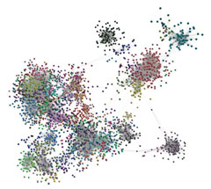
Variation and interaction of the transcriptome
General patterns of (mRNA), miRNA, and splicing variation in populations
How does miRNA (and lncRNA) regulate mRNA levels?
Coexpression networks
Stochastic variation in transcription levels (and splicing)
miRNAs and canalization
Genetic control of transcriptional variation
gene expr level
expr variance
miRNA expr level
genotype

Slide 10
Genetic effects on regulatory variation
trans-eQTLs
common/rare cis-variants
independent effects
splicing QTLs
miRNA/mRNA interactions
eQTL analysis
ASE analysis
splicing QTL analyses
Fine-mapping the causal regulatory variants

Slide 11
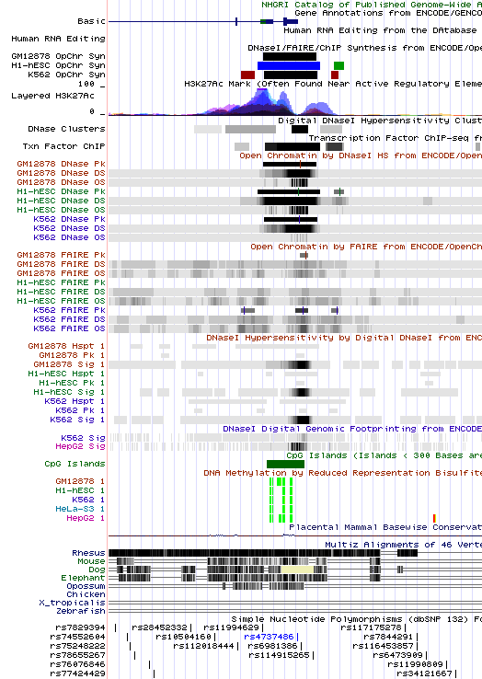
How do genetic variants affect transcriptional regulation
Integration with functional annotation of the genome: ENCODE, conservation, etc
Regulatory effect of different types of variants
10,2 M SNPs
3,2 M small indels
3,576 large deletions
joint effects of independent regulatory variants for the same gene
Will we have power to predict regulatory impact of variants based on their properties?

Slide 12
Evolutionary background of regulatory variation
Differences between populations
Selective constraint on different types of variants
eQTLs for mRNA and miRNA, miRNA target sites, splicing QTLs…
Adaptive evolution
independent eQTLs and soft sweeps
transcriptional networks as the target of selection
Epistatic selection between cis-regulatory and coding variants
talk today at 5:20pm

Slide 13
Role of regulatory variation in disease
Impact size of rare / common regulatory variants
Loss-of-function variants
Functional validation of annotated coding loss-of-function variants
Identification of putative regulatory loss-of-function variants
Overlap with GWAS hits

Slide 14
How will we get there?
Sequencing ongoing
deadline February 15
Pipeline for the low-level data processing – must be clear before we have the data
Detailed planning of different segments of the analysis and assignment of responsibilities
Discussion 3:30 pm today!

Slide 15
Acknowledgements
UNIGE (Geneva)
Manolis Dermitzakis
Stylianos Antonarakis
Tuuli Lappalainen
Thomas Giger
Emilie Falconnet
Luciana Romano
Alexandra Planchon
CRG/CNAG/USC (Barcelona)
Xavier Estivill
Ivo Gut
Roderic Guigo
Angel Carracedo Alvarez
Gabrielle Bertier
Esther Lizano
Micha Sammeth
ICMB (Kiel)
Stefan Schreiber
Philip Rosenstiel
Matthias Barann
MPIMG (Berlin)
Hans Lehrach
Ralf Sudbrak
Marc Sultan
LUMC (Leiden)
Gert-Jan van Ommen
Peter ‘t Hoen
UU (Uppsala)
Ann-Christine Syvänen
Mathias Brännvall
HMGU (Munich)
Thomas Meitinger
Tim Strom
EBI
Paul Flicek
Natalja Kurbatova
Ilkka Lappalainen
ECACC
Bryan Bolton
Karen Ball
Edward Burnett
Jim Cooper
Let me know who’s missing!
Check out the WP4 wiki: www.geuvadis.org > Private > Wikis

